Slide 1

MICRO CREDIT LOAN PREDICTION

Slide 2
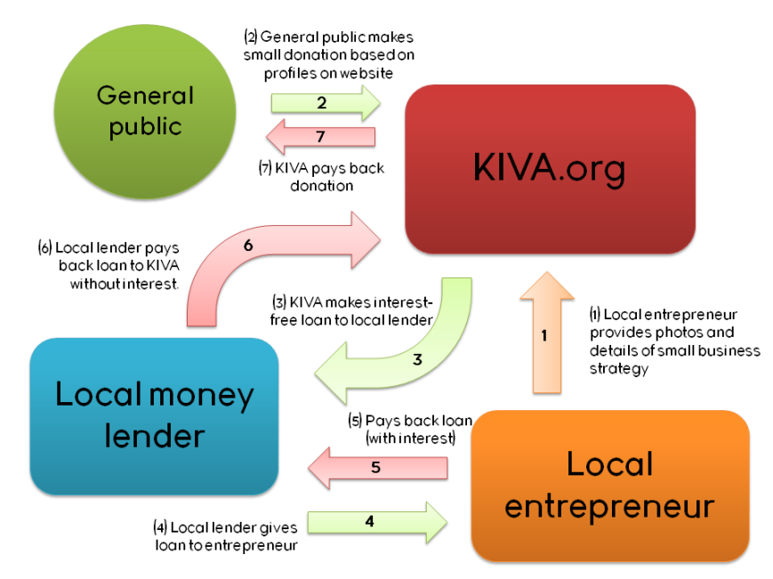
What is Micro Credit?
This Photo by Unknown Author is licensed under CC BY-SA-NC

Slide 3
Objectives of Micro Finance institutions
Promoting socio-economic development at the community level;
Developing and strengthening self-help groups and facilitating sustainable development through them;
Providing vocational training to unskilled population;
Empowerment of women;
Conducting programs for the poor;
Promoting sustainable agriculture and sound conservation of natural resources;
Organizing and coordinating based on the grass-root level;
Making efficient use of the available resources for the generation of livelihood.

Slide 4
Business Problem Framing
Microcredit is a method of lending very small sums to individuals to start or expand a small business.
Microcredit borrowers tend to be low-income individuals living in parts of the developing world; the practice originated in its modern form in Bangladesh.
Most microcredit schemes rely on a group borrowing model, originally developed by Nobel Prize winner Muhammad Yunus and his Grameen Bank.
The Micro finance Company is basically the financial institutions that provide small-scale financial services in the form of loan, credit or savings. These companies are introduced to ease the credit system for small businesses as they don’t get a loan from banks due to their complex process. Therefore it is commonly named as a Micro-credit, Micro-benefit organization. They offer small loans to various small businesses or households that do not have access to formal banking channels or eligibility for loans.
They provide small loans that are less than Rs.50,000 for rural areas and for urban it is Rs.1,25,000. The simplest way to register a Microfinance Company in India is to register the Section-8 Company with MCA (Ministry of Corporate Affairs). Without charging any marginal money or guarantee security. It can give loans at inexpensive rates directed by the RBI and central government. They are a huge support to all rural and agricultural development including income and employment creation.

Slide 5
Conceptual Background of the Domain Problem:
Micro credit is “Loan of very small amount”. It can be defined as provision of parsimony, credit and other financial services and products of very small amount to the poor in rural, semi-urban and urban areas for enabling them to raise their income levels and improve living standards.
Today, microfinance is widely accepted as a poverty-reduction tool, representing $70 billion in outstanding loans and a global outreach of 200 million clients.
We are working with one such client that is in Telecom Industry. They are a fixed wireless telecommunications network provider. They have launched various products and have developed its business and organization based on the budget operator model, offering better products at Lower Prices to all value conscious customers through a strategy of disruptive innovation that focuses on the subscriber.
They understand the importance of communication and how it affects a person’s life, thus, focusing on providing their services and products to low-income families and poor customers that can help them in the need of hour.
They are collaborating with an MFI to provide micro-credit on mobile balances to be paid back in 5 days. The Consumer is believed to be defaulter if he deviates from the path of paying back the loaned amount within the time duration of 5 days. For the loan amount of 5 (in Indonesian Rupiah), payback amount should be 6 (in Indonesian Rupiah), while, for the loan amount of 10 (in Indonesian Rupiah), the payback amount should be 12 (in Indonesian Rupiah).

Slide 6
Review of Literature
Microcredit is a part of microfinance. The term Microfinance is used for the provision of a wider range of financial services to the very po
The innovative idea of Microcredit originated with the Grameen Bank in Bangladesh. In 1976 Professor Muhammad Yunus, launched a research project to examine the possibility of designing a credit delivery system to provide banking services targeted to the rural poor. Yunus began the project in a small town called Jobra, using his own money to deliver small loans at low-interest rates to the rural poor.
Grameen Bank has successfully enabled extremely impoverished people to engage in self-employment projects that allow them to generate an income and, in many cases, begin to build wealth and exit poverty. Different types of institutions that provides micro credit loans in India are:
Commercial banks.
Credit unions.
Non-governmental organisations (NGOs)
Sectors of government banks.
Cooperatives.

Slide 7
Motivation for the Problem Undertaken
In India we see many families under below poverty Line, by using these techniques we can also implement many such micro credit programs in India and help the needy who seek for the loan.
In India, the National Bank for Agriculture and Rural Development (NABARD) finances more than 500 banks that on-lend funds to self-help groups (SHGs). SHGs comprise twenty or fewer members, of whom the majority are women from the poorest castes and tribes.
Members save small amounts of money, as little as a few rupees a month in a group fund. Members may borrow from the group fund for a variety of purposes ranging from household emergencies to school fees. As SHGs prove capable of managing their funds well, they may borrow from a local bank to invest in small business or farm activities. Banks typically lend up to four rupees for every rupee in the group fund. In Asia borrowers generally pay interest rates that range from 30% to 70% without commission and fees. Nearly 1.4 million SHGs comprising approximately 20 million women now borrow from banks, which makes the Indian SHG-Bank Linkage model the largest microfinance program in the world.
So In-order to help our people we have to conduct many such services and help them for their development.

Slide 8
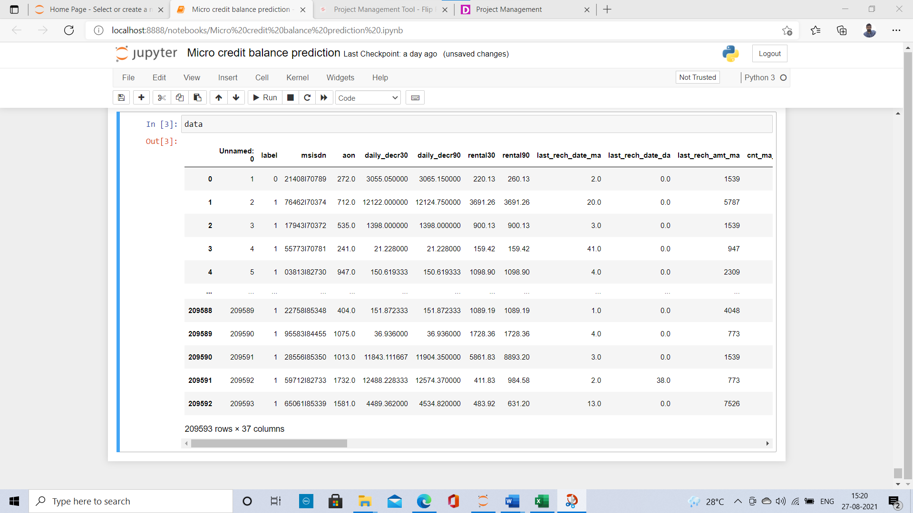
Data Sources and their formats
Our dataset consists of Features and label. The label indicates the loan payment weather the consumer paid back the amount balance. Micro-credit on mobile balances to be paid back in 5 days. The Consumer is believed to be defaulter if he deviates from the path of paying back the loaned amount within the time duration of 5 days. For the loan amount of 5 (in Indonesian Rupiah), payback amount should be 6 (in Indonesian Rupiah), while, for the loan amount of 10 (in Indonesian Rupiah), the payback amount should be 12 (in Indonesian Rupiah). On the basis of that the label is given as 1 and 0. 1 is success and 0 is failure, which means the consumer paid back the loan amount or not.

Slide 9
Data Pre-processing Done
First I have imported all the libraries like pandas, Numpy, matplotlib, seaborn, etc… by using pandas technique I imported the CSV file. After that I checked shape of the data, next I have checked for the Null Values using is-null () method and then I have checked for type of the data using info method which gives the information about the data. After that I have checked for the stats of the columns.
In the dataset there is a column with msisdn which gives the information of the consumers mobile number which is not required for our prediction so I have dropped that column and there are more two columns of object type they are pcircle and date pcircle which is a telecom circle which s of same throughout the column and the date column which are not required for our prediction so I have dropped those two columns. In our dataset all the columns has skewness and outliers present which need to be handled.

Slide 10
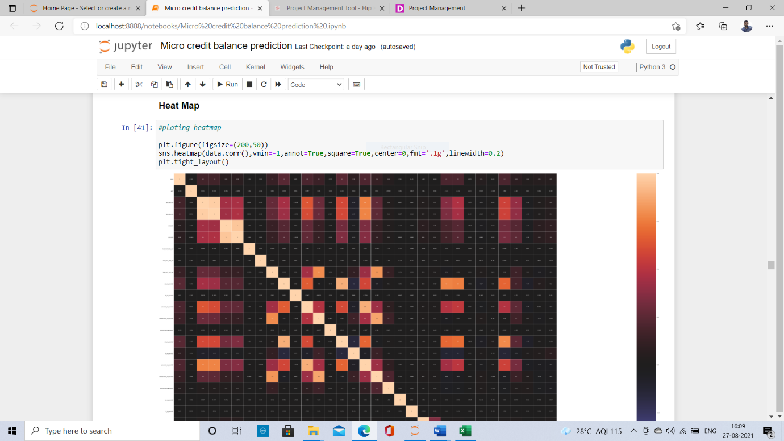
Data Inputs- Logic- Output Relationships
The dataset consists of features and label. The features are independent and label is dependent as the values of our independent variables changes as according our label varies.
To find the relation between our features and label, I have used correlation matrix and heap map plot for visualising the correlation. From that I found that our label is not that correlated with the features. Very less of 10% and 20% correlated with some of the features.
1.The light colored squares are highly correlated and dark colored are less correlated.
2.The daily_decr30 is highly correlated with daily_decr90
3.The label is not much correlated with any of the feature.
4.But there is multicollinearity exists with the features.

Slide 11
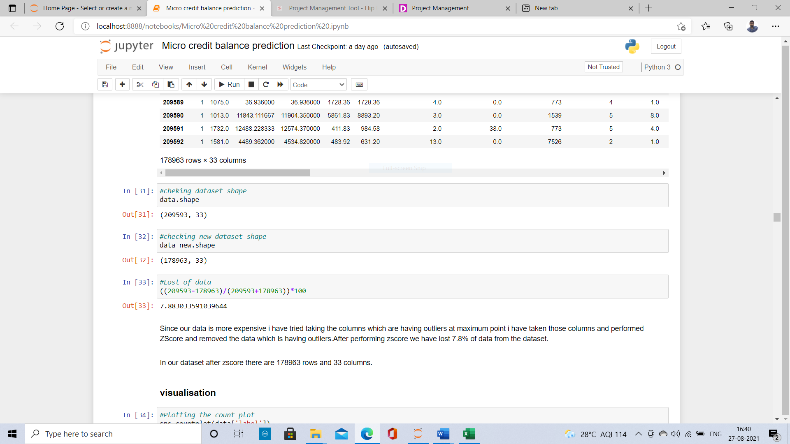
State the set of assumptions (if any) related to the problem under consideration
In our columns we have many outliers present when we apply Z-Score for removing the outliers on all the columns we are losing more than 12% of data. As the data is more expensive we cannot loose the data more than 8%. So for that reason what I did is I have checked all the outliers by plotting the box plot then the features which are having more outliers which are at maximum point I took those columns and performed Z- score on those features after that we have lost 7.8% data which are having maximum outliers.

Slide 12
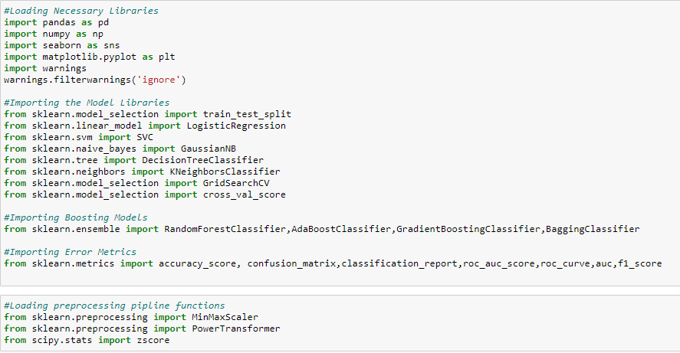
Hardware and Software Requirements and Tools Used I have used my laptop, Jupiter Notebook which is having GUI interface. Imported necessary libraries from python such as pandas, NumPy, seaborn, matplotlib, then imported the required model libraries from Scikit learn to import our algorithms, after that imported the package called imblearn for up-sampling the label using SMOTE.

Slide 13
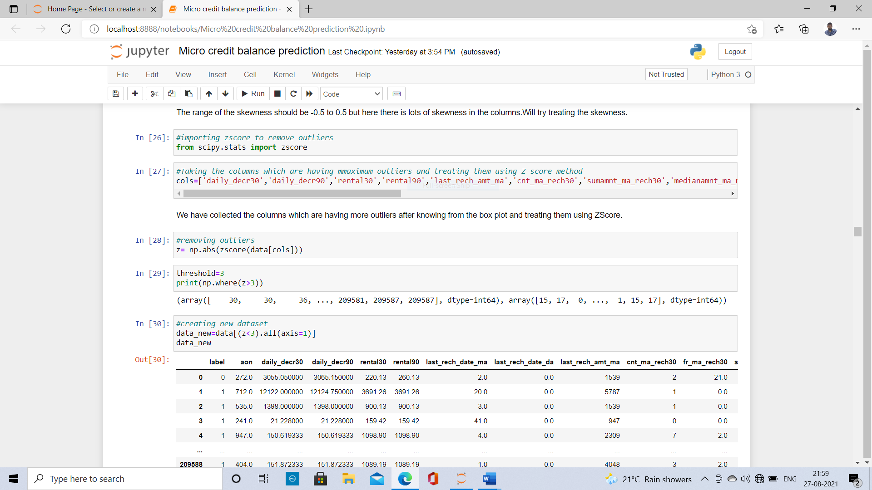
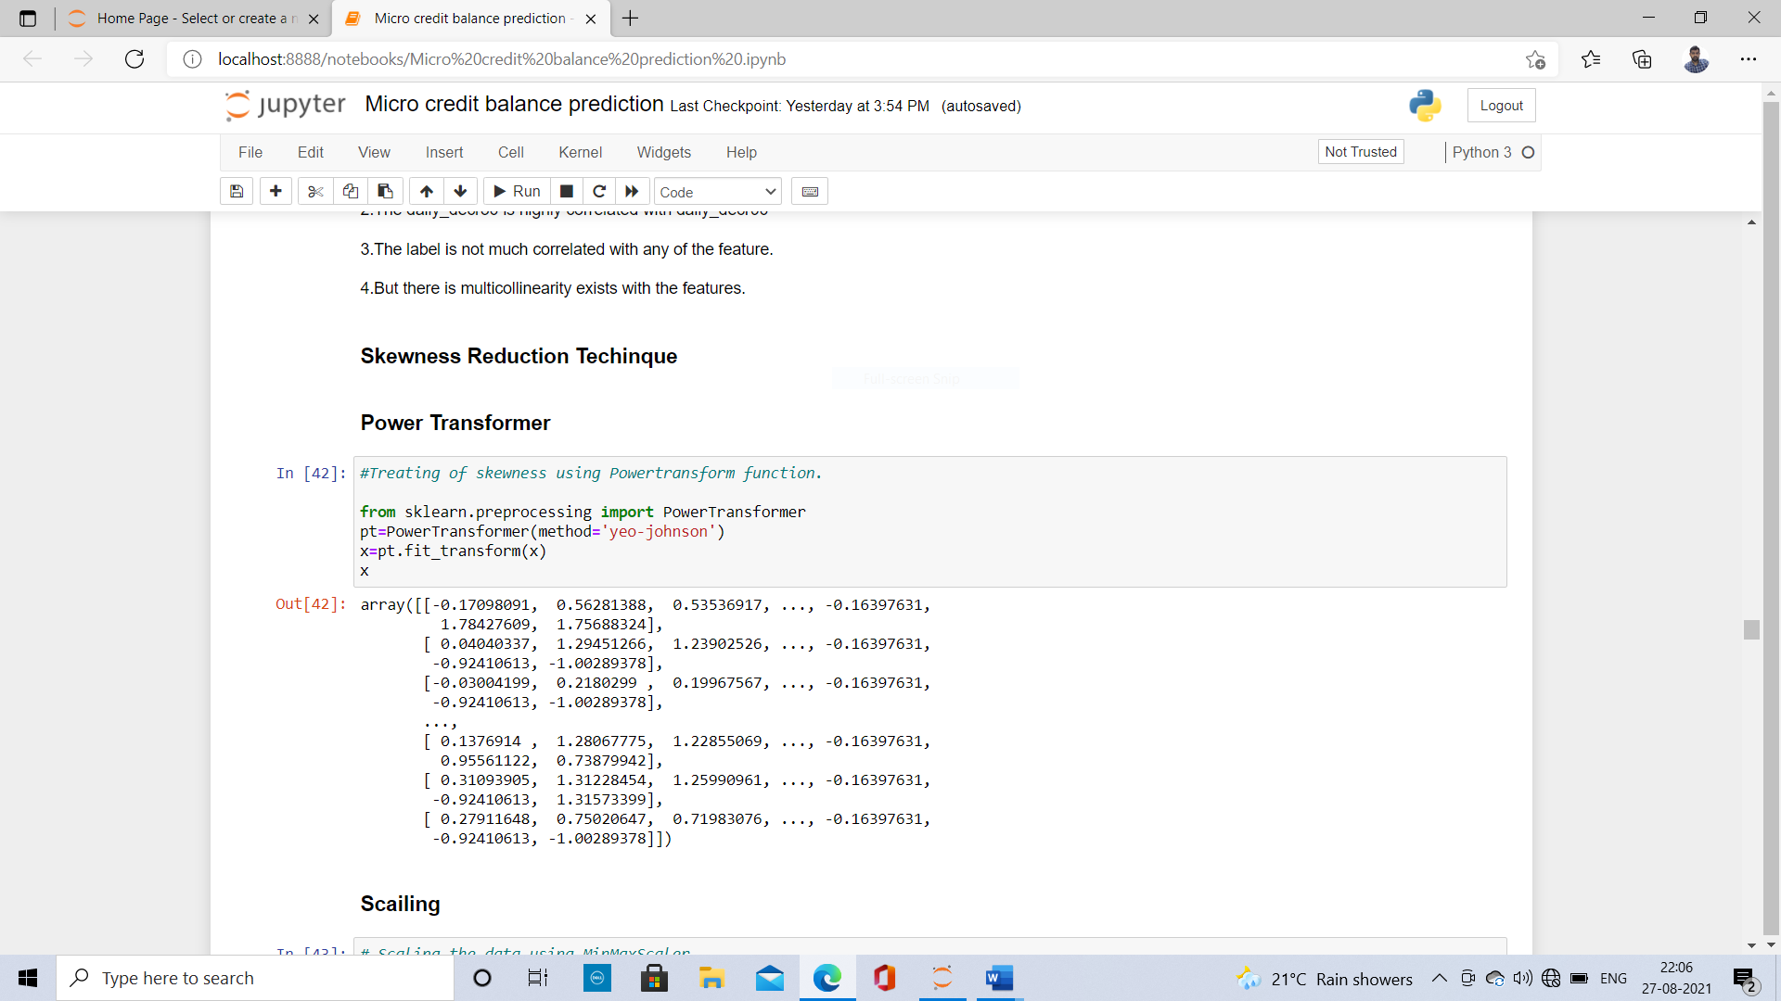
Model/s Development and Evaluation
I have plotted Box plot and distribution plot on all the columns and checked the skewness and outliers present in the data after plotting I got to know that there is lots of skewness in the columns and presence of outliers in all the columns. So in order to remove the outliers I have applied Z-Score and removed the outliers which has max effect on the label prediction.

Slide 14
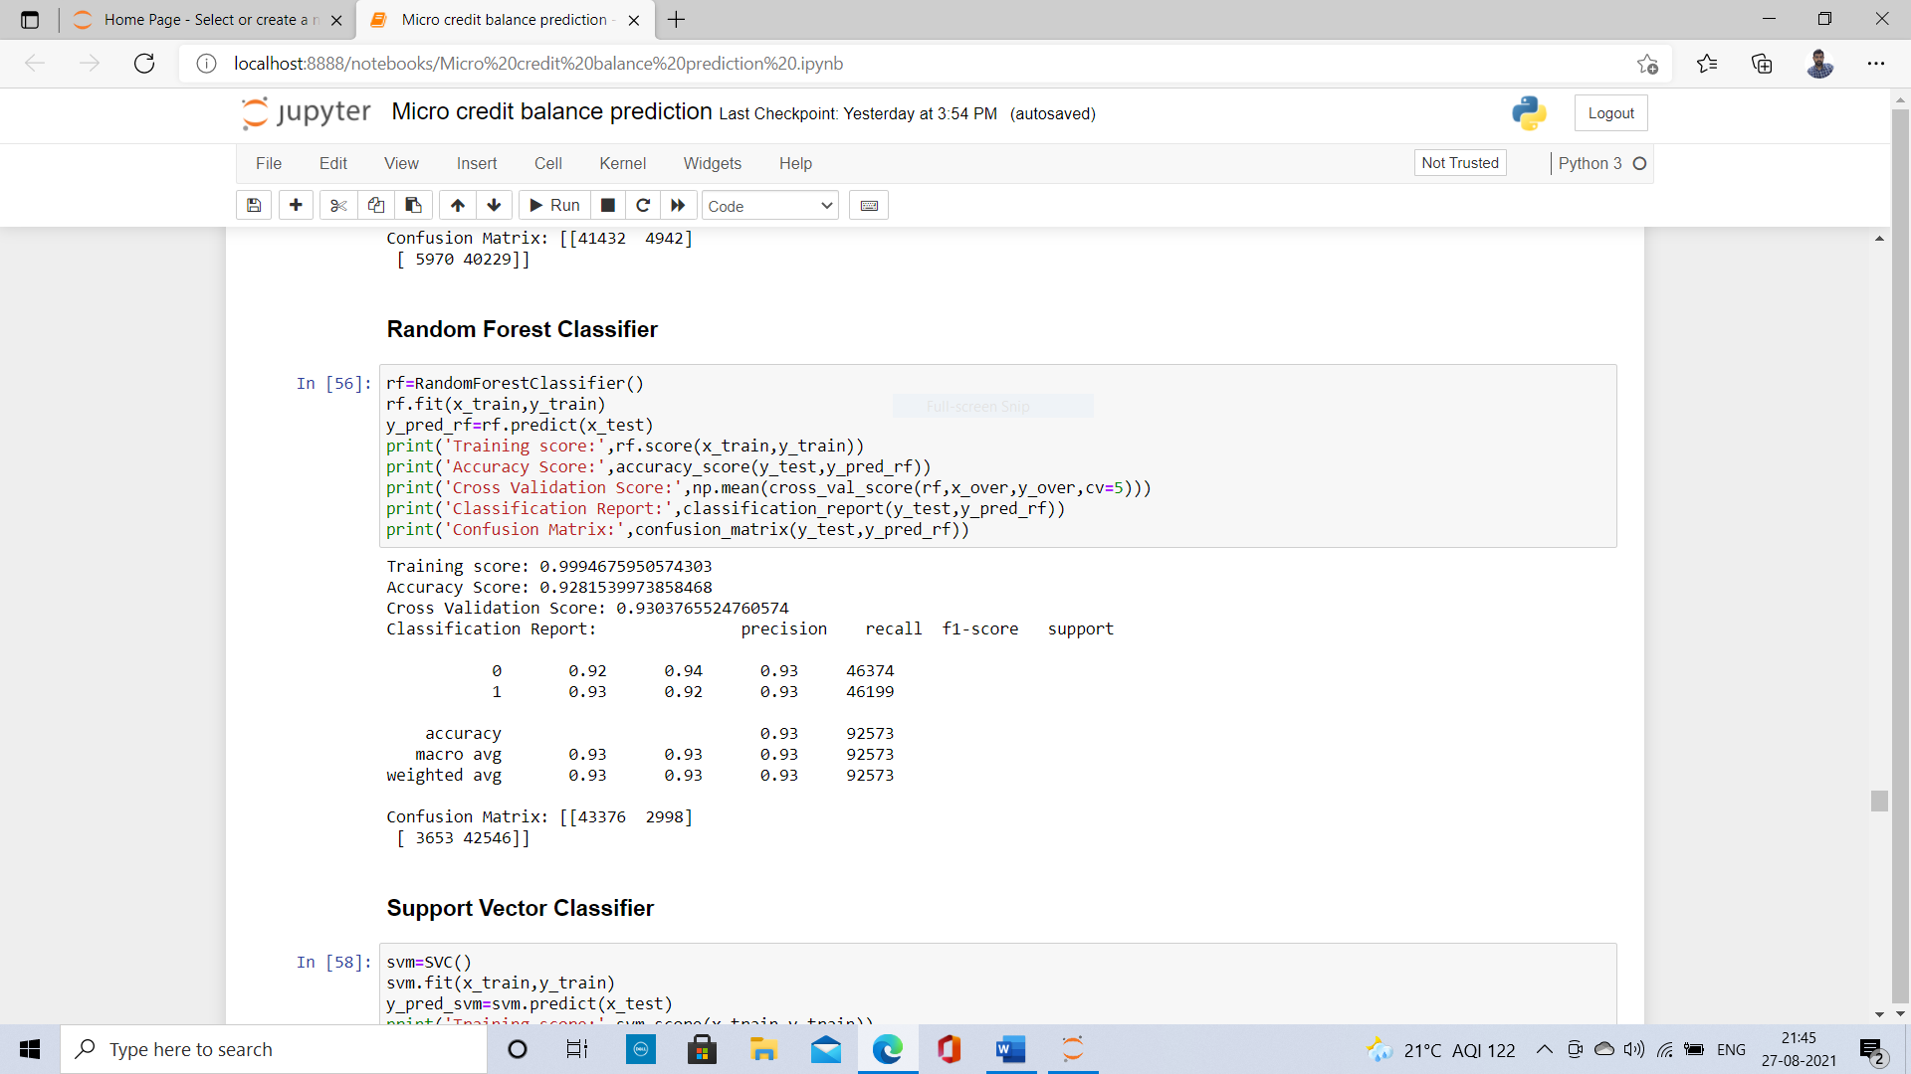
Testing of Identified Approaches (Algorithms)
Since the label has two classes this type of problem comes under binary classification. So I have used all the classification Algorithms to predict our label which gives the different patterns on different model. The Algorithms I have used are Logistic Regression, K-Neighbors Classifier, Decision Tree Classifier, Random Forest Classifier, Support Vector classifier and Gaussian Navie Bayes. The metrics I have used for evaluating the models are accuracy score, cross validation score, precision, recall, Confusion matrix and ROC AUC score.

Slide 15
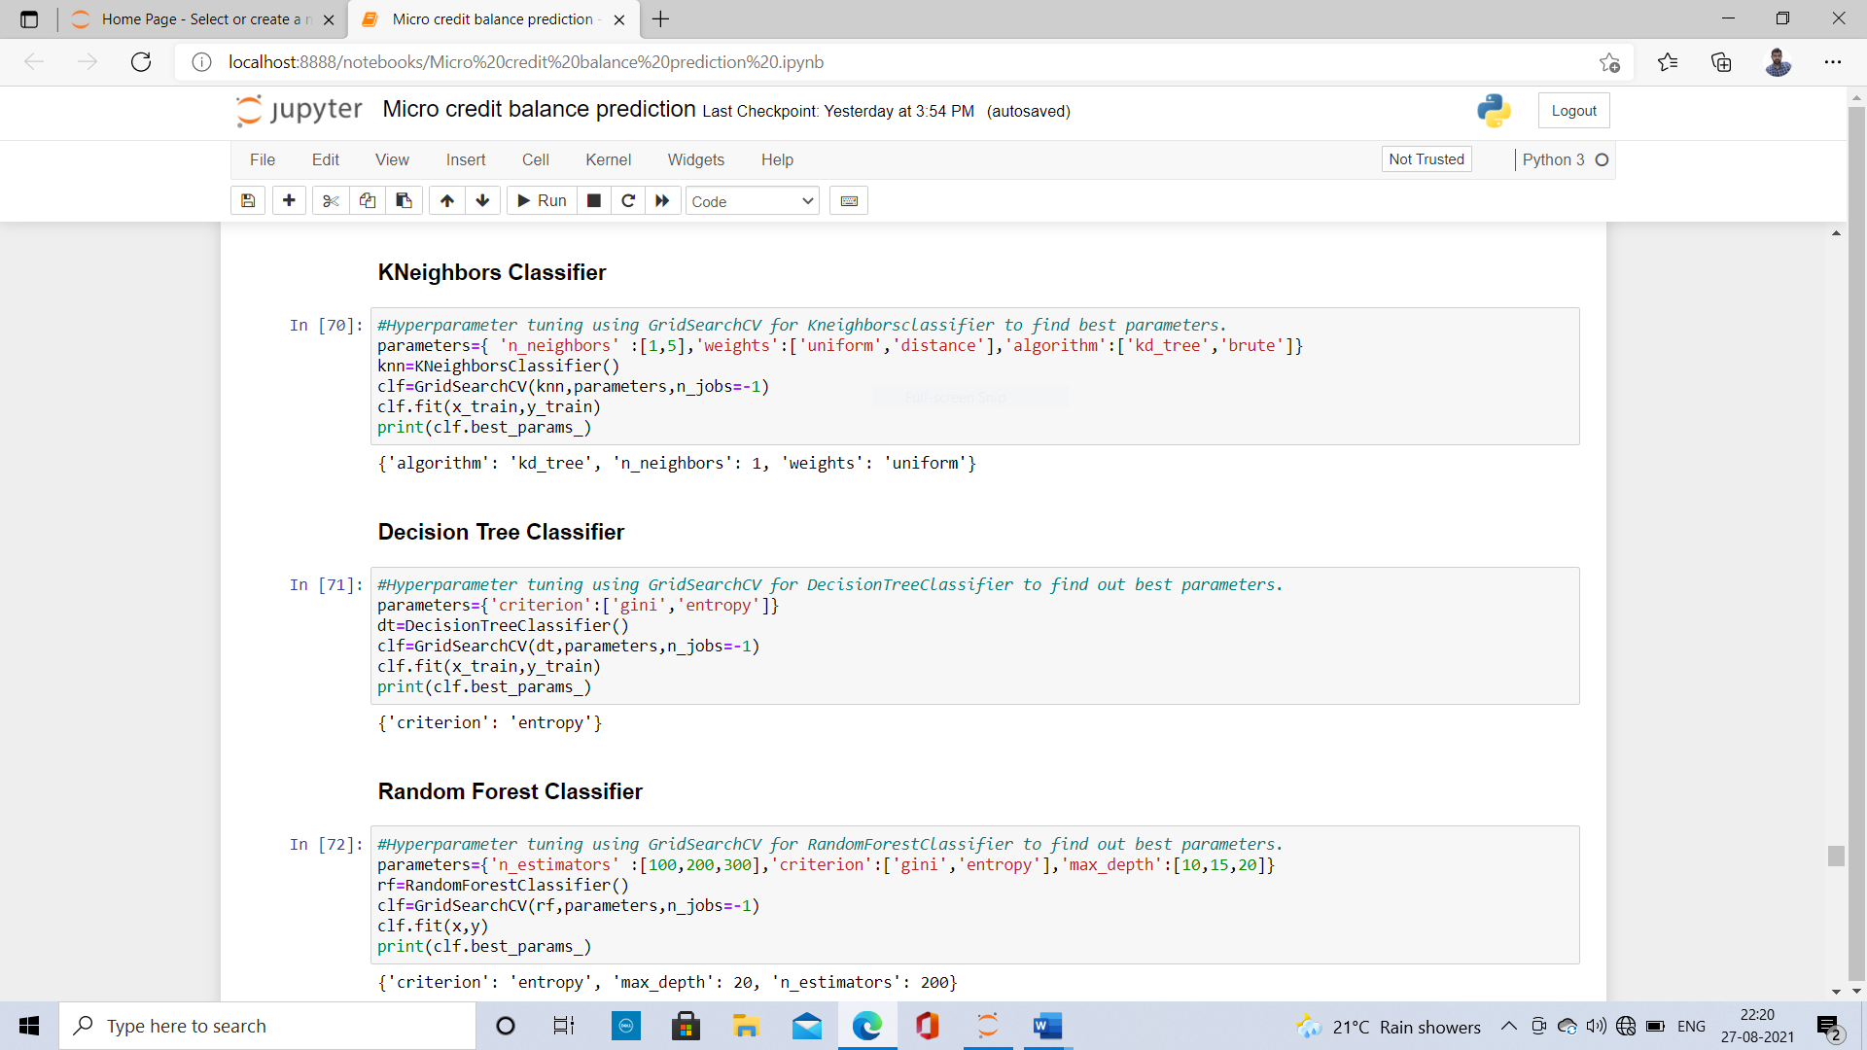
Key Metrics for success in solving problem under consideration
After Checking the models evaluation I have considered Logistic Regression, K Neighbors classifier, Decision Tree Classifier and Random Forest as my final models and I have applied hyperparameter tuning for improving the scores. By using Grid search CV we are going to pass different parameters for all the fitted algorithms which improves the evaluation of models.

Slide 16
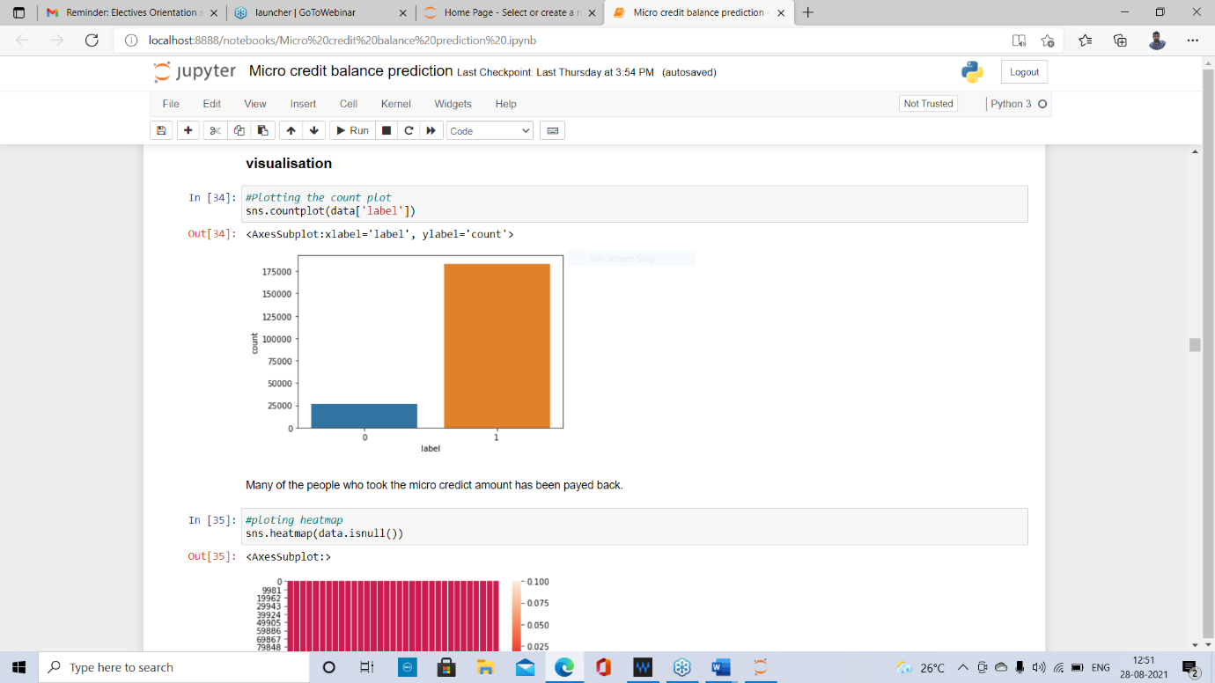
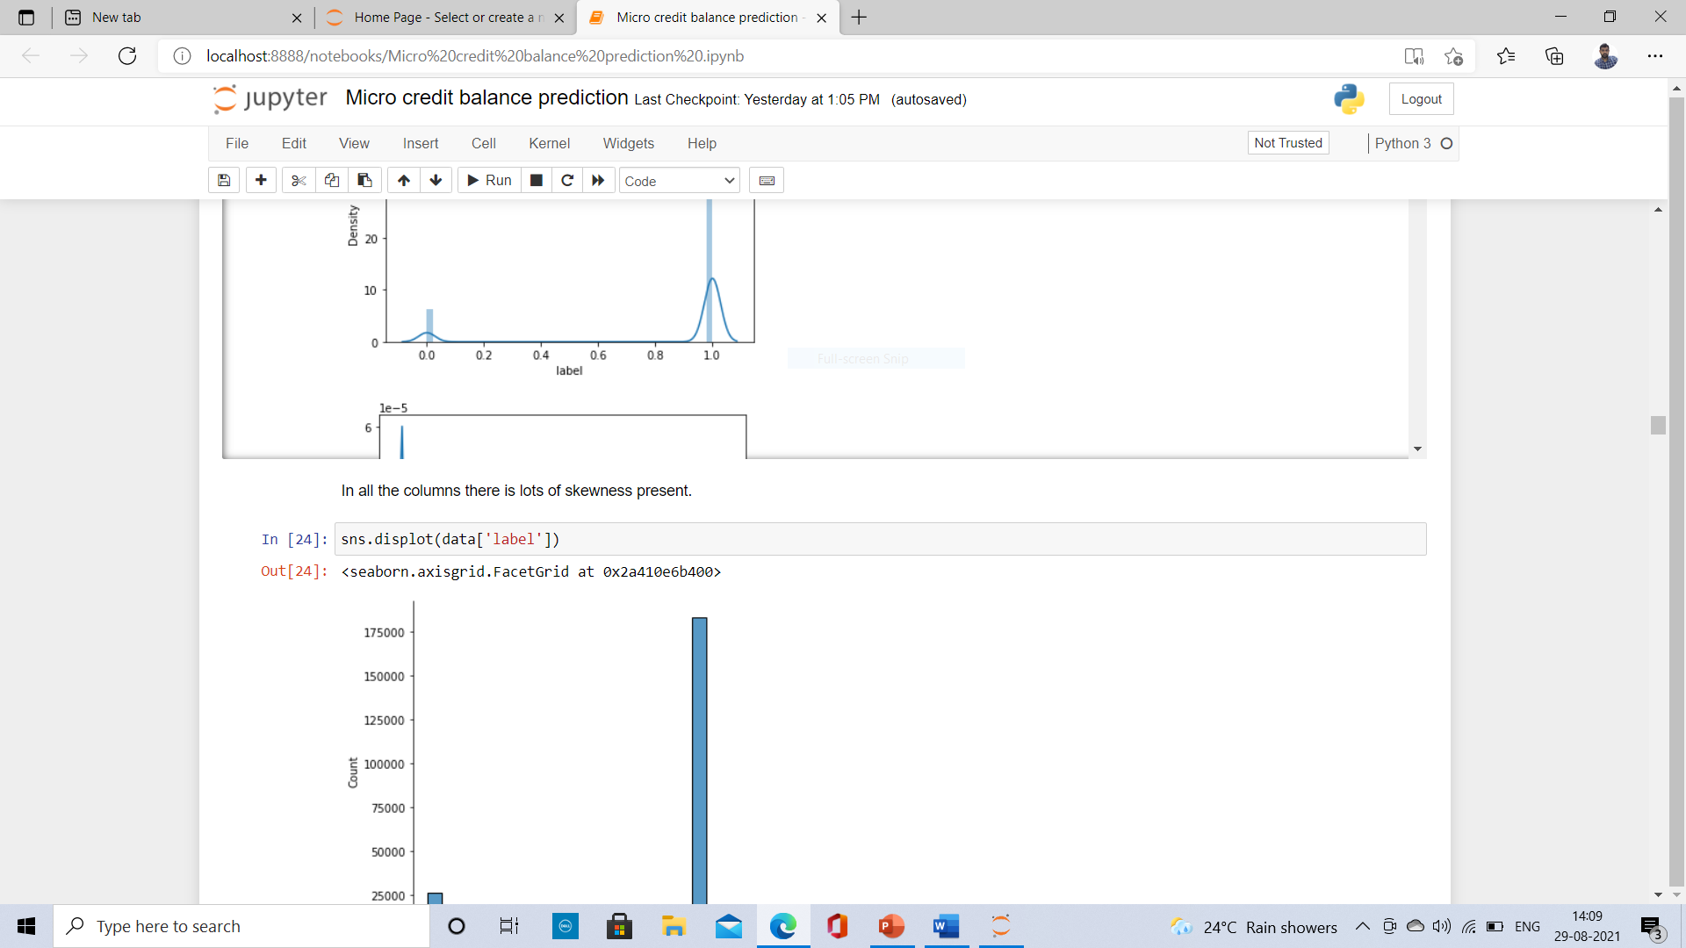
Visualizations
First I have visualised for finding outliers and skewness of the data in the columns using box plots and distribution plots respectively. After plotting I found out that there are large number of outliers and skewness in the data of all the columns. I have tried to fix them using some techniques. Then I plotted count plot on label since it has two classes then I got to know that the label is unbalanced which indicates success and failure of loan payment..

Slide 17
Interpretation of the Results
Index | Models | Accuracy score | F1- score | ROC AUC Score
0 | Random Forest Classifier | 0.9138733756062782 | 0.92 | 0.9281403650674581
1 | KNeighbors Classifier | 0.9067654715737851 | 0.91 | 0.8665676027720839
2 | Decision Tree classifier | 0.8837133937541184 | 0.89 | 0.8821040440133816
3 | Support Vector classifier | 0.7727415121039612 | 0.78 | 0.7726922211921375
4 | Logistic Regression | 0.7579315783219729 | 0.76 | 0.8825779985183999

Slide 18
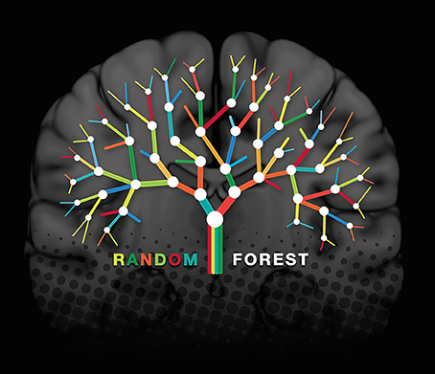
Conclusions on our model building
After fitting many models like logistic regression , KNeighbors classifier, Decision Tree Classifier, Random Forest Classifier, Support vector classifier, Gaussian Navie Bayes classifier ,Our Random Forest classifier has best performance in terms of Accuracy Score, Cross validation score, Precision, Recall, F1 score, ROC AUC Score. So I have considered Our ensemble technique as our final model building.

Slide 19
Advantages of Micro Finance company
Collateral free loan
Quick Disbursal of loan
Extensive portfolio of loans
Self sufficiency and entrepreneurship

Slide 20
Disadvantages
Harsh Repayment method.
Small loan amount
High interest rate

Slide 21
Conclusions
Today, microfinance is widely accepted as a poverty-reduction tool. Providing, Micro credit loans to low-income population was a good idea, which was first implemented in Bangladesh in 1976, by Muhammad Yunus, who is a professor(economist), who was started with a group of women borrowing $27 to finance the group's own small businesses. The women repaid the loan and were able to sustain the business. Now various financial institutions, banks, NGO’s are coming up with great credit facilities in many sectors such as agriculture, small-scale business, telecom service etc.
By providing such type of schemes for low-income people like daily wagers, small scale industries, etc… so that the people can sustain themselves in their business or fields or they can fulfil their basic needs. So the micro financial institutions must increase their Donors for funding them and check out themselves weather they can provide all such type loans for people who will be seeking for the help. They should be in a position to provide all type loan sanctions to low-income people. If and when needed, governments should adjust regulatory frameworks to permit all types of financial institutions to offer services to poor people. The Government has to conduct many programs on micro credit loans for the people to get awareness in such type of getting credits.

